Slide 1
Stack in Data Structure

Slide 2
Stack is a linear data structure which follows a particular order in which the operations are performed. The order may be LIFO(Last In First Out) or FILO(First In Last Out).
Stack is an abstract data type with a bounded(predefined) capacity. It is a simple data structure that allows adding and removing elements in a particular order. Every time an element is added, it goes on the top of the stack and the only element that can be removed is the element that is at the top of the stack, just like a pile of objects.

Slide 3
Applications of Stack
The simplest application of a stack is to reverse a word. Push a given word to stack - letter by letter - and then pop letters from the stack.
There are other uses also like:
Parsing
Expression Conversion(Infix to Postfix, Postfix to Prefix etc)

Slide 4
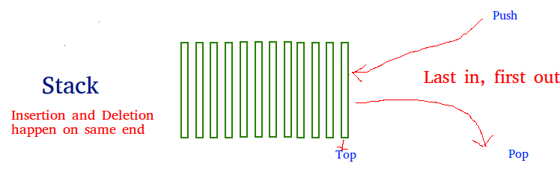
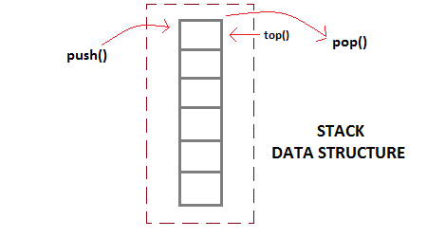

Slide 5
Operation of Stack
Stack is an ordered list of similar data type.
Stack is a LIFO(Last in First out) structure or FILO(First in Last out).
push() function is used to insert new elements into the Stack
pop() function is used to remove an element from the stack.
Both insertion and removal are allowed at only one end of Stack called Top.
isFull() function is used to check for full
Stack is said to be in Overflow state when it is completely full
isEmpty() function is used to check for empty
Stack is said to be in Underflow state if it is completely empty.
Stack_Top() To show top element
List() To show all elements

Slide 6
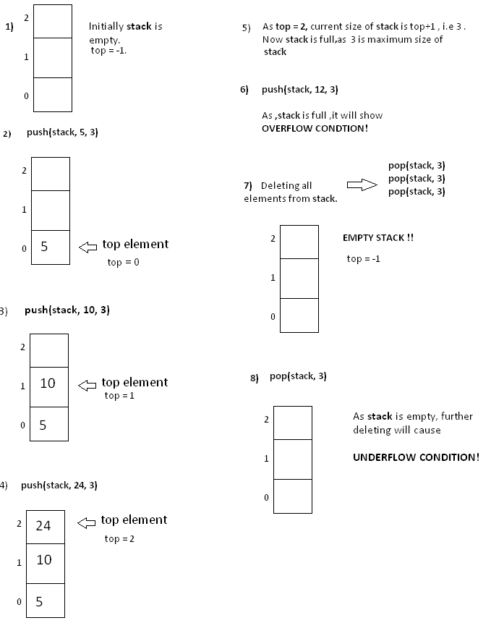

Slide 7
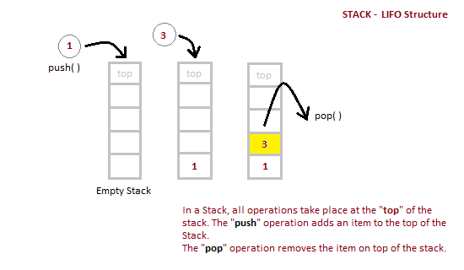
Implementation of Stack Data Structure

Slide 8
Algorithm for PUSH operation
Check if the stack is full or not.
If the stack is full, then print error of overflow and exit the program.
If the stack is not full, then increment the top and add the element.
Algorithm for POP operation
Check if the stack is empty or not.
If the stack is empty, then print error of underflow and exit the program.
If the stack is not empty, then print the element at the top and decrement the top

Slide 9
Position of Top | Status of Stack TopTop
Top=-1 | Stack is Empty
0 | Only one element in Stack
Top = N-1 | Stack is Full
N | Overflow state of Stack

Slide 10
Operations on Stack
push( x ) : insert element x at the top of stack.
void push (int stack[ ] , int x , int n)
{
if ( top == n-1 ) //if top position is the last of position of stack, means stack is full
{
Printf(“Stack is full.Overflow condition!”) ;
}
Else
{
top = top +1 ; //incrementing top position
stack[ top ] = x ; //inserting element on incremented position .
} }

Slide 11
pop( ) : removes element from the top of stack.
void pop (int stack[ ] ,int n )
{
if( isEmpty ( ) )
{
Printf(“Stack is empty . Underflow condition! ” );
}
else
{
top = top - 1 ; //decrementing top’s position will detach last element from stack .
}
}

Slide 12
Stack_top( ) : access the top element of stack.
int Stack_top( )
{
return stack[ top ];
}

Slide 13
Analysis of Stack Operations
Below mentioned are the time complexities for various operations that can be performed on the Stack data structure.
Push Operation : O(1)
Pop Operation : O(1)
Top Operation : O(1)
Search Operation : O(n)
The time complexities for push() and pop() functions are O(1) because always have to insert or remove the data from the top of the stack, which is a one step process.

Slide 14
#include<stdlib.h>
#include<stdio.h>
#include<conio.h>
#define MAX 10
struct stack
{
int items[MAX];
int top;
};
void main()
{
int c=1, ch, n;
//struct stack s;

Slide 15
int isFull(struct stack*);
void push(struct stack*, int);
int isEmpty(struct stack*);
int pop(struct stack*);
int stack_top(struct stack*);
void list(struct stack*);
struct stack s;
s.top=-1;
while(c)
{
clrscr();
printf("main menu");

Slide 16
printf("\n 1. Push the element");
printf("\n 2. Pop the element");
printf("\n 3. See the top element");
printf("\n 4. List all element");
printf("Exit");
printf("\n Enter your choice=");
scanf("%d",&ch);
switch(ch) {
case 1:
if(isFull(&s)==1)
{
printf("stack is overflow");
getch(); }

Slide 17
else
{
printf("Enter any number:");
scanf("%d", &n);
push(&s, n);
}
break;
case 2:
if(isEmpty(&s)==1)
{
printf("stack Underflow");
getch(); }

Slide 18
else
{
printf("Deleted number=%d", pop(&s));
getch();
}
break;
case 3:
if(isEmpty(&s)==1)
{
printf("stack Underflow");
getch();
}

Slide 19
else
{
printf("Top number=%d", stack_top(&s));
getch();
}
break;
case 4:
if(isEmpty(&s)==1)
{
printf("stack Underflow");
getch();
}

Slide 20
else
{
list(&s);
getch();
}
break;
case5:
exit(0);
}}}

